Slide 1

12:34
12:39
12:49
12:52

Slide 2




Slide 4


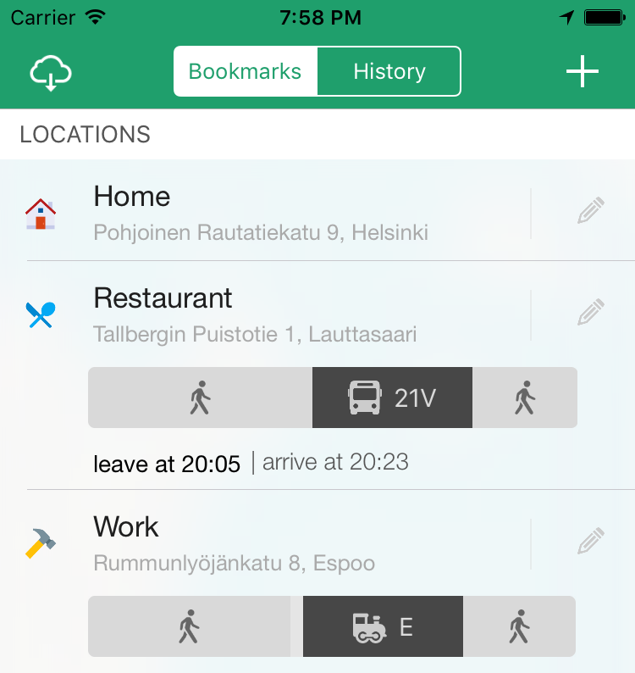

Slide 5



Slide 6


Slide 7








Slide 10


Slide 11
Helsinki 12:30
http://www.fontspace.com/category/thin?p=2
http://www.fontspace.com/nimavisual/trench

Slide 12




Slide 13





Slide 16






Slide 17
M

Slide 18


Slide 19



Slide 20


Slide 21





Slide 22


Slide 27





Slide 28


Slide 29



Slide 42



Slide 43


Slide 44


Slide 45


Slide 48


Slide 49


Slide 50







Slide 51





Slide 52


Ewket Apps
®
Ewket Apps
®

Slide 53










Slide 55




Slide 56


Slide 57



Slide 59

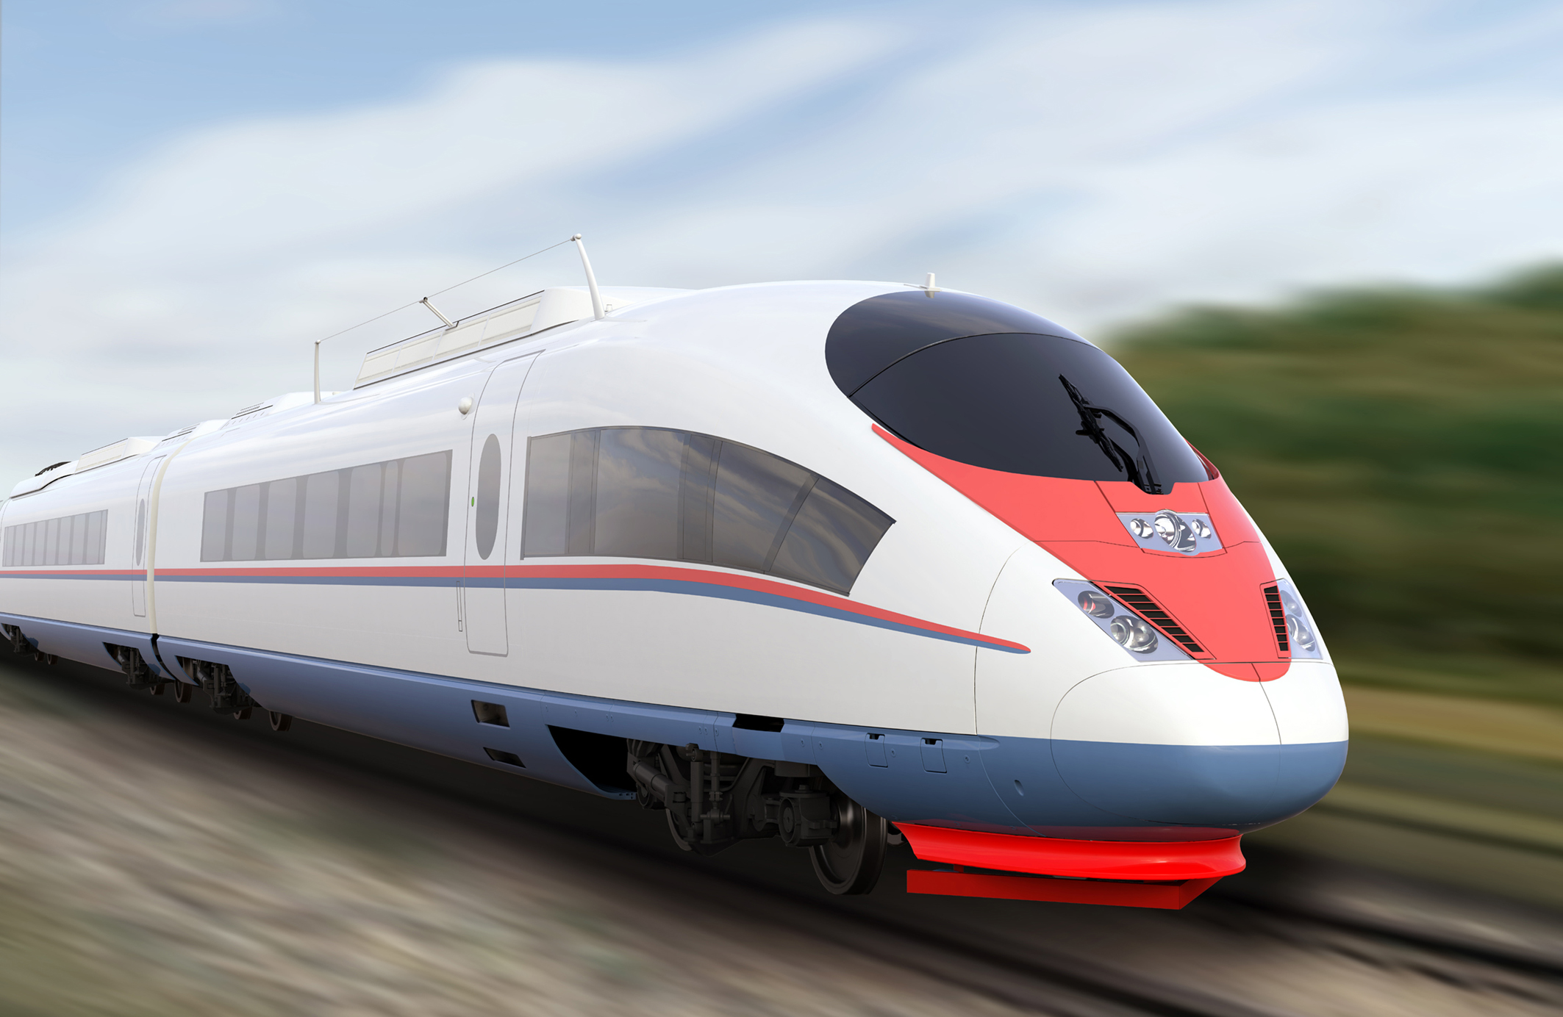

Slide 61
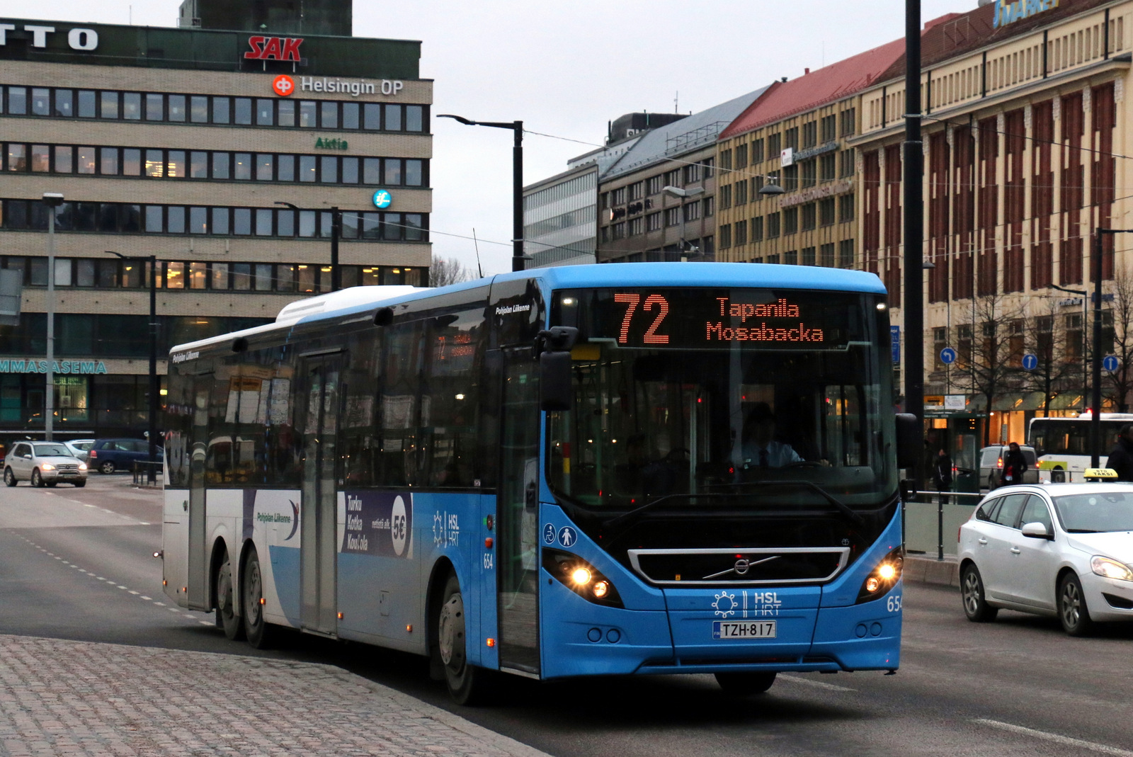

Slide 63


Slide 64
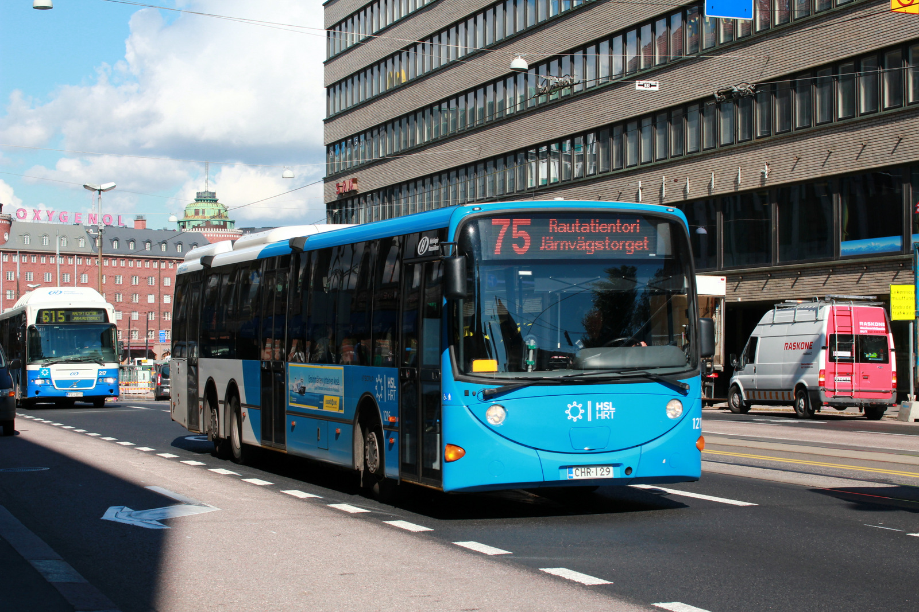

Slide 65


Slide 66
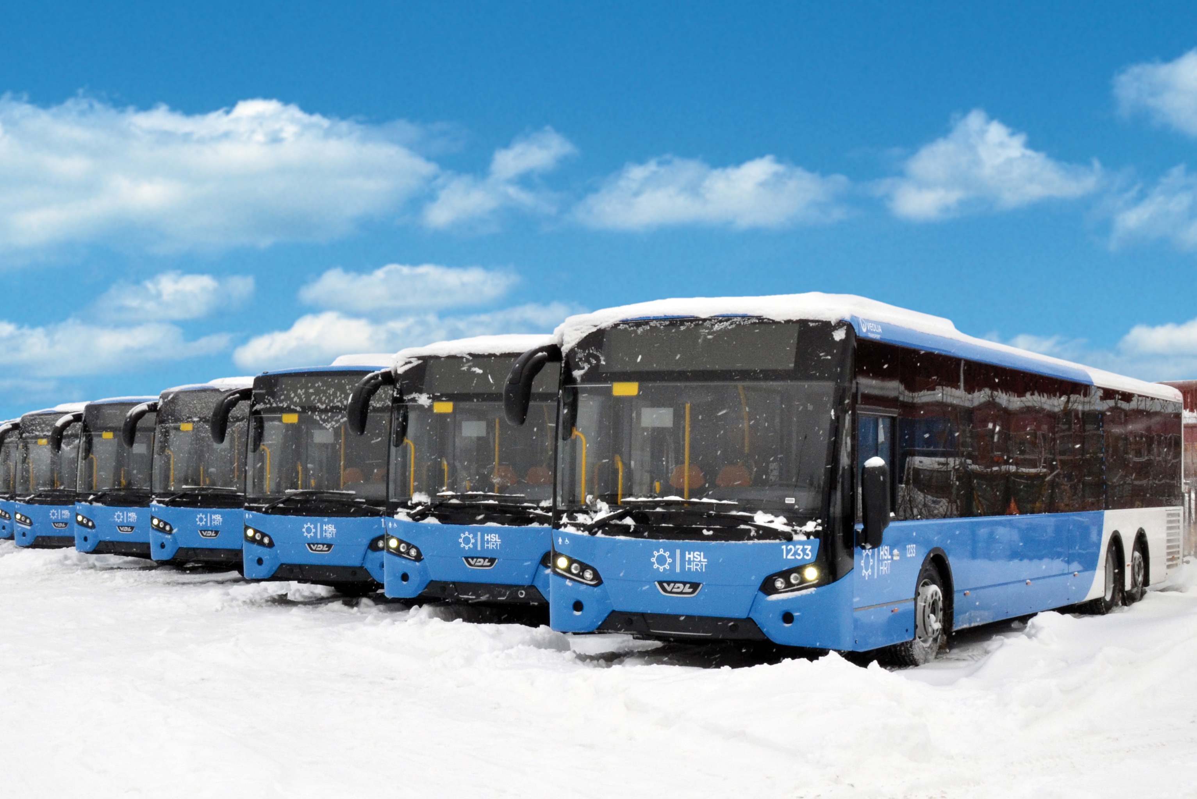

Slide 68
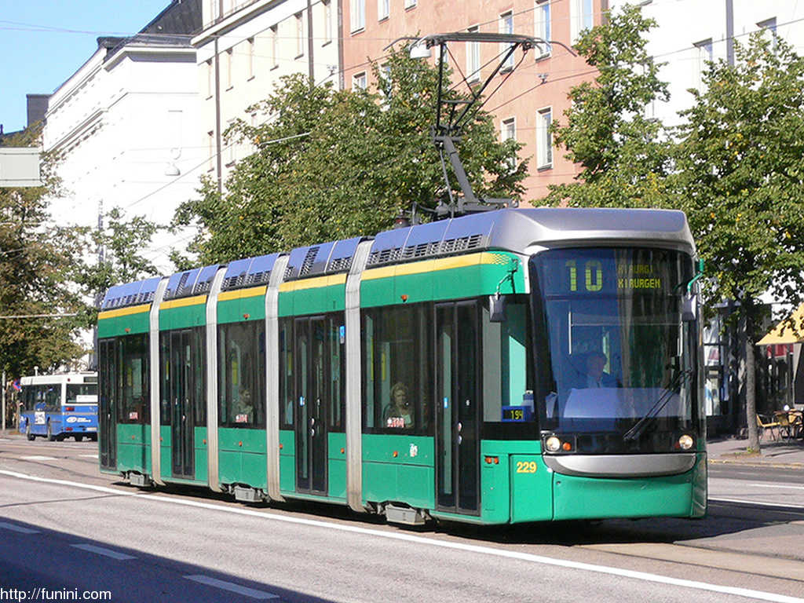

Slide 70


Slide 72
C
B
A - > C
B -> X
X = (b * C)/A
Dif = (A – B)/2
A
C * (1 – B/A)/2

